Slide 1
PINPOINT
Improved Postal Codes for India

Slide 2
What is Pinpoint?
New Postcode system
On the lines of the postcode system in the UK, each Pinpoint will correspond to a small number of postal addresses
An address database that includes the Pinpoint for each address

Slide 3
Why?
Ecommerce journey in India has two specific pain points at present
When the customer inputs addresses
Free text entry leads to errors and inconsistencies
During the last mile delivery
Addresses hard to locate in certain areas
Erroneous or improper address input by customer worsens the situation
Zippr is one of the emerging solution in this space. However,
Customer needs to sign up to obtain a Zippr
No hierarchy or structure
Better to create a system that is structured hierarchically and is not customer led
Using existing India Post hierarchy (pin code + beat code)
Customers and logistic partners might have to embrace a third party location code like Zippr if eCommerce sites start relying more and more on a code like Zippr
Unhelpful for sorting purposes as it would be more complicated
Minimal larger good as the codes would be randomly assigned – A structured code would help emergency services greatly and allow better geographic demarcation for most departments and organisations

Slide 4
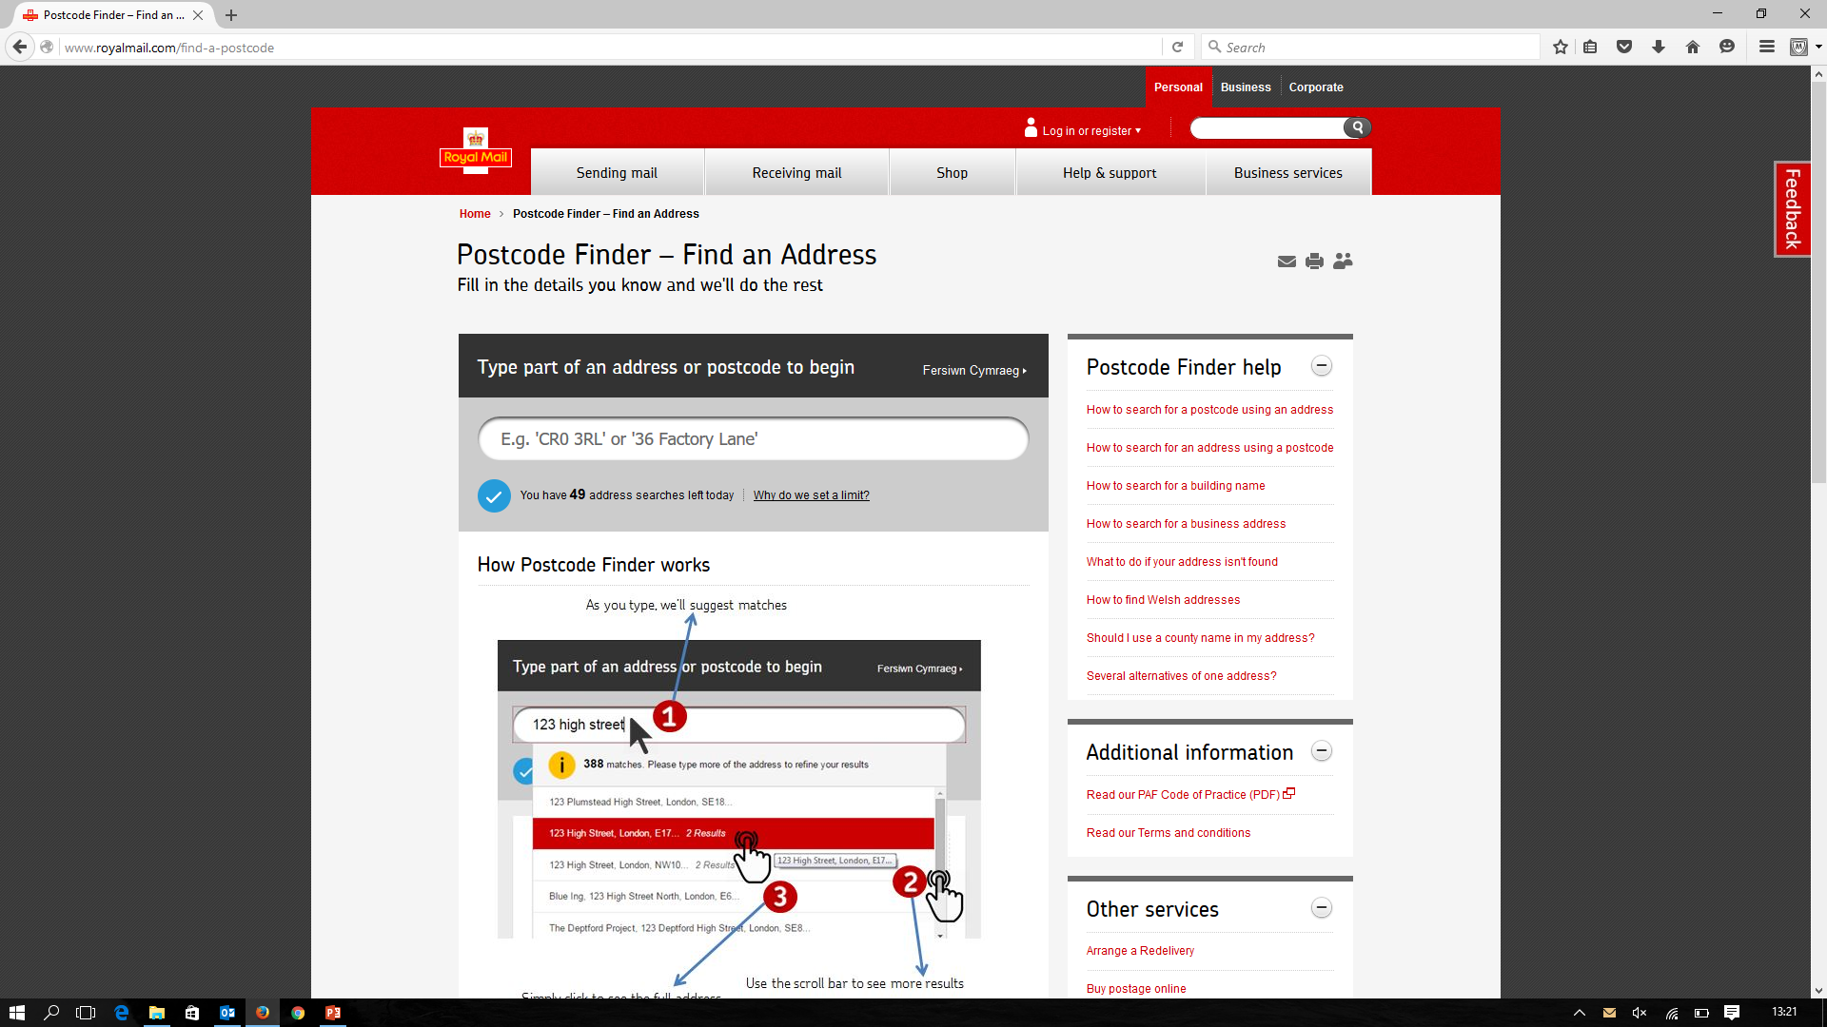
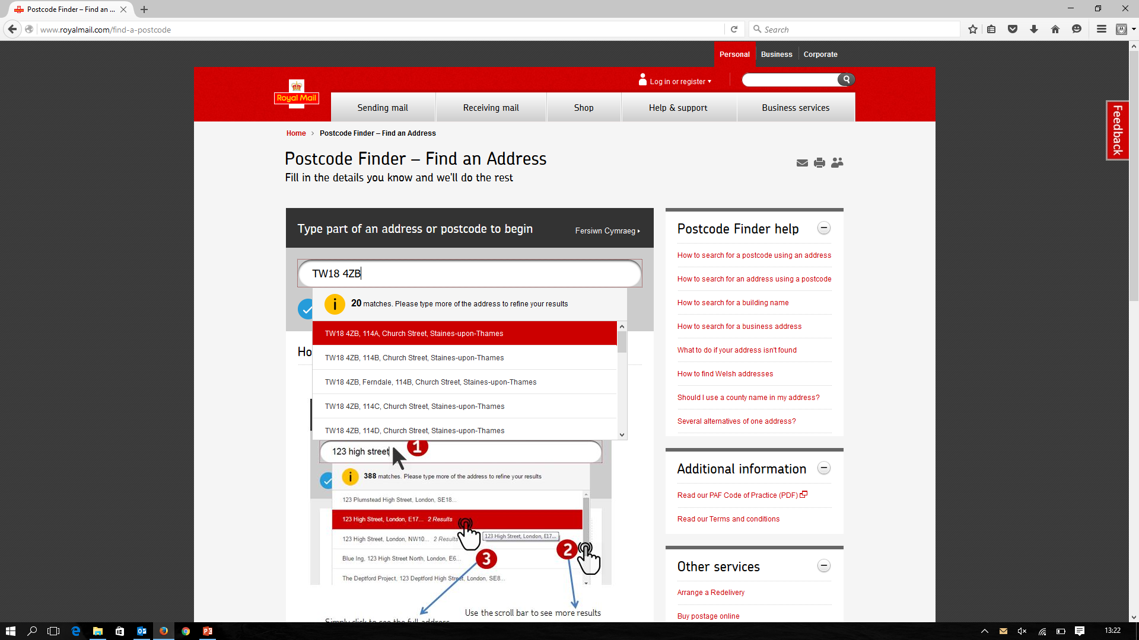
UK Postcode

Slide 5
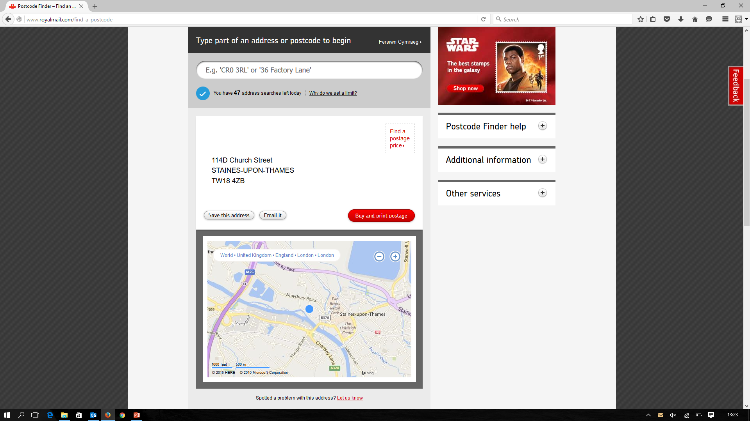
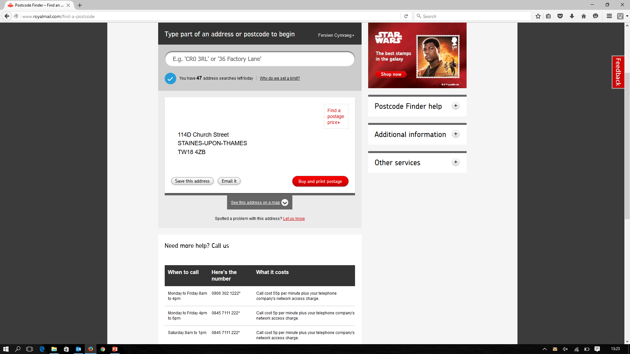
UK Postcode

Slide 6
Format of Pinpoint
Examples
AD7D – 8BT
PR3C – 1AA
AE91 – 7UR
Alphanumeric [ Capital letters and digits]
Provision for eight characters, but seven might be sufficient to begin with
For the 4th position, letters B, I, O, S and Z are excluded from use and for the 8th position, digits 8, 1, 0, 5 and 2 are excluded to avoid any confusion
Further, if necessary, Letters/Digits could be allowed in all positions to increase the number of postcodes
The idea is for Sector to represent a beat and the Patch to represent a group of properties
Sector |  |  |  | - | Patch
1 | 2 | 3 | 4 | - | 5 (Future Use) | 6 | 7 | 8
Letter | Letter | Digit | Digit / Letter | Separator | Digit | Digit | Letter | Letter / Digit
26 | 26 | 10 | 31 | - | 10 | 10 | 26 | 31

Slide 7
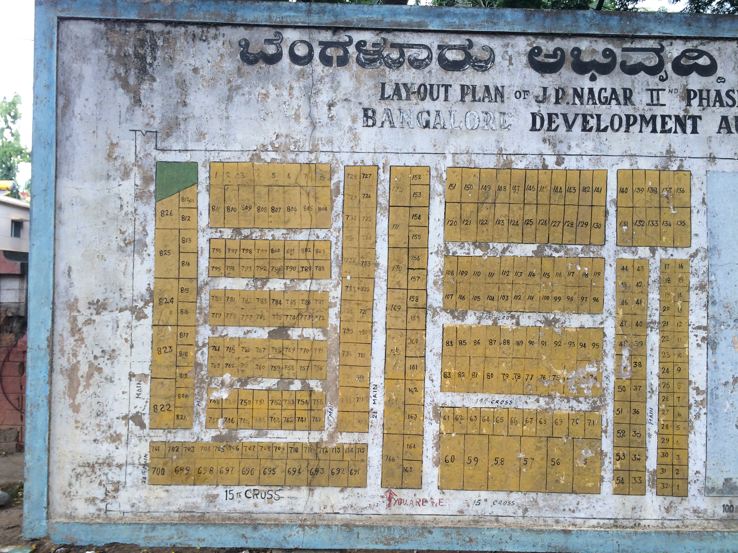
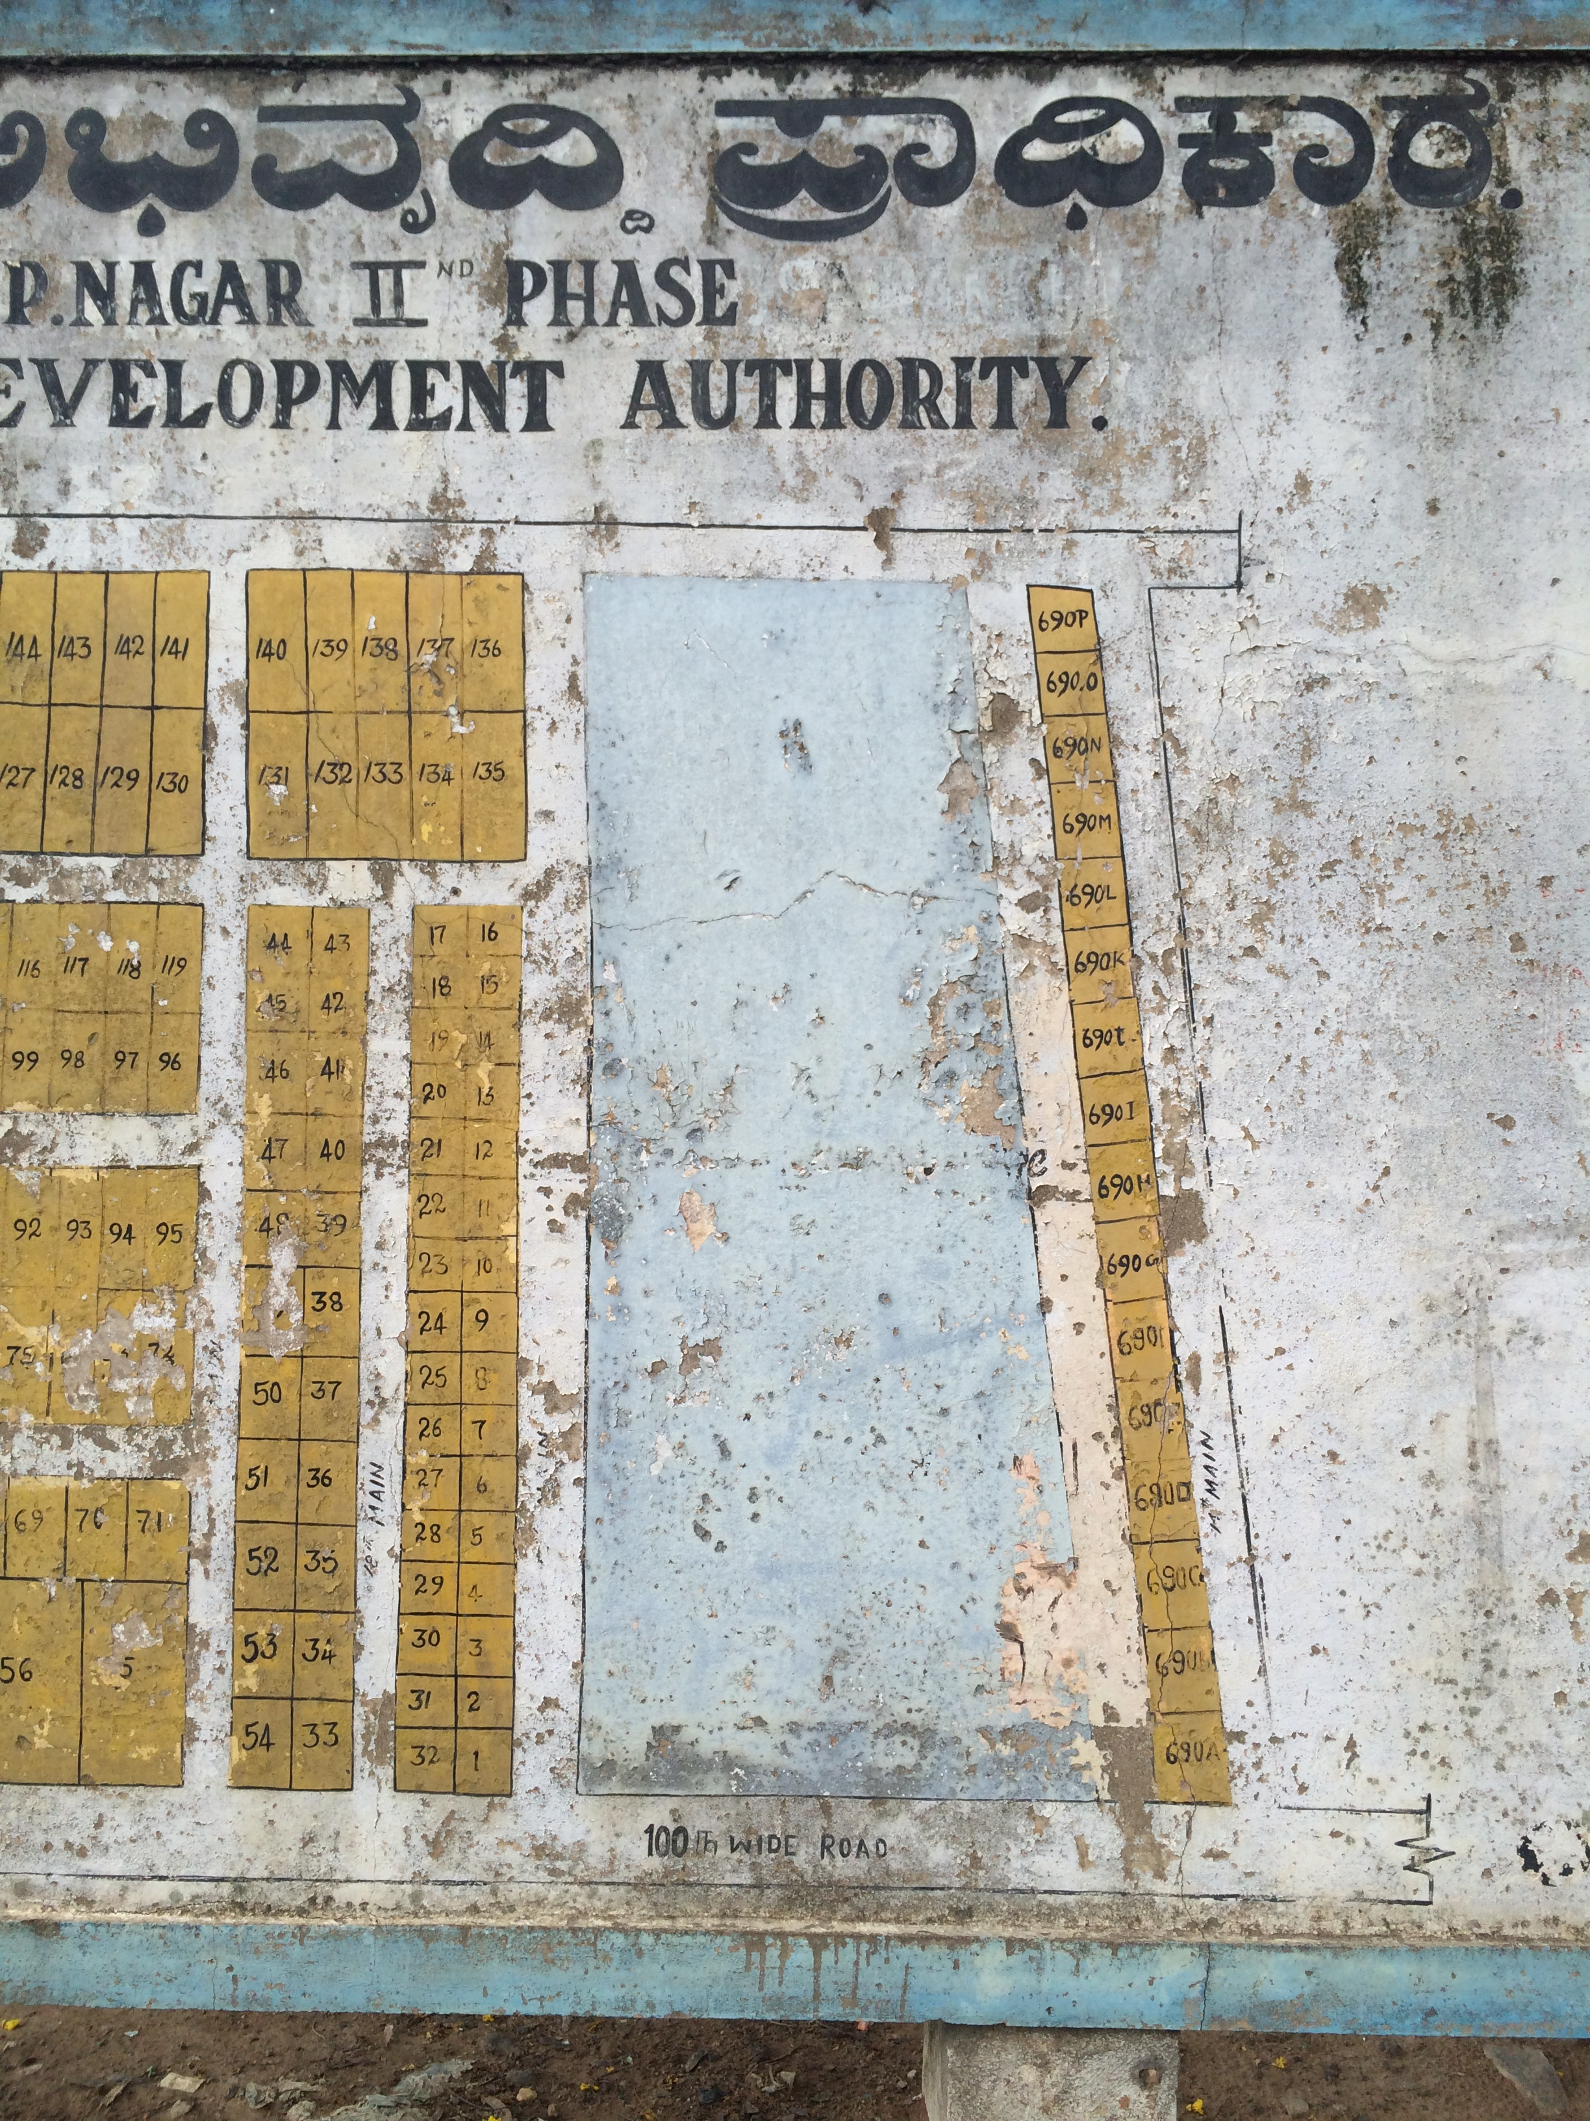

Slide 8
AD7D – 1AH
AD7D – 1AK
AD7D – 1AL
AD7D – 1AG
AD7D – 1AM
AD7D – 1AC
AD7D – 1AI
AD7D – 1AF
AD7D – 1AJ
AD7D – 1AN
AD7D – 1AR
AD7D – 1AE
AD7D – 1AP
AD7D – 1AQ
AD7D – 1AD
AD7D – 1AO
AD7D – 1AB

Slide 9
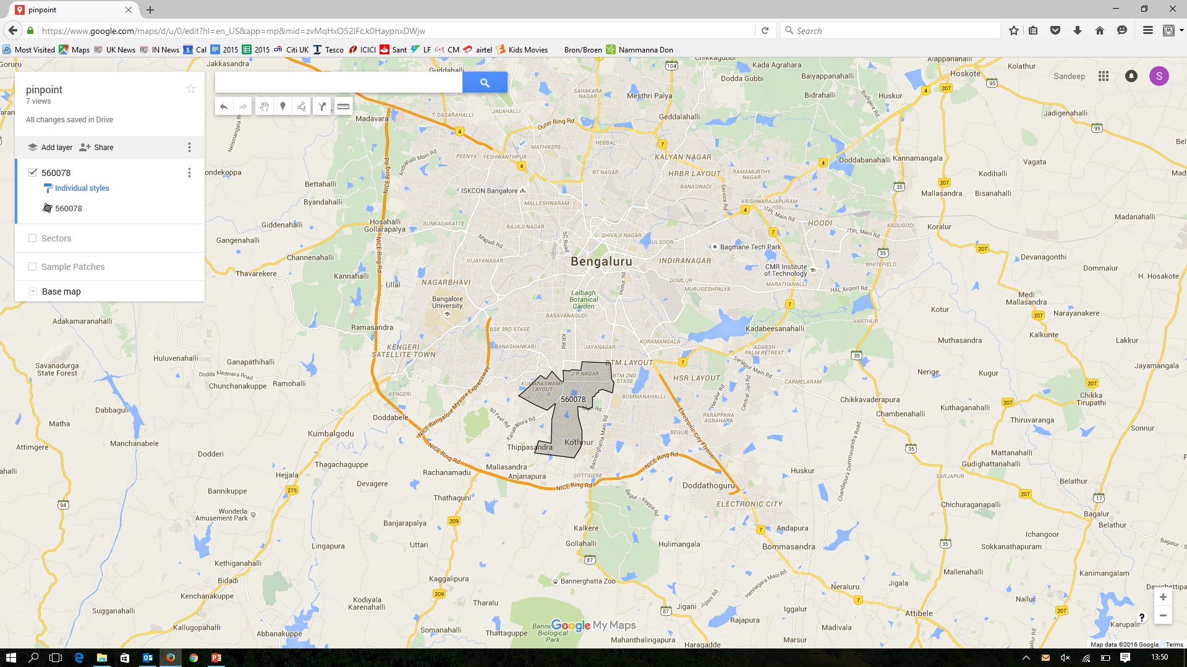
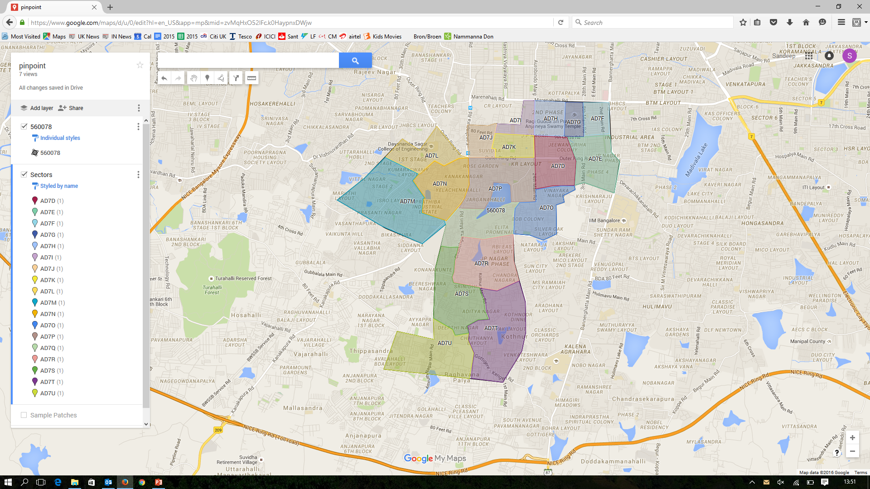

Slide 10
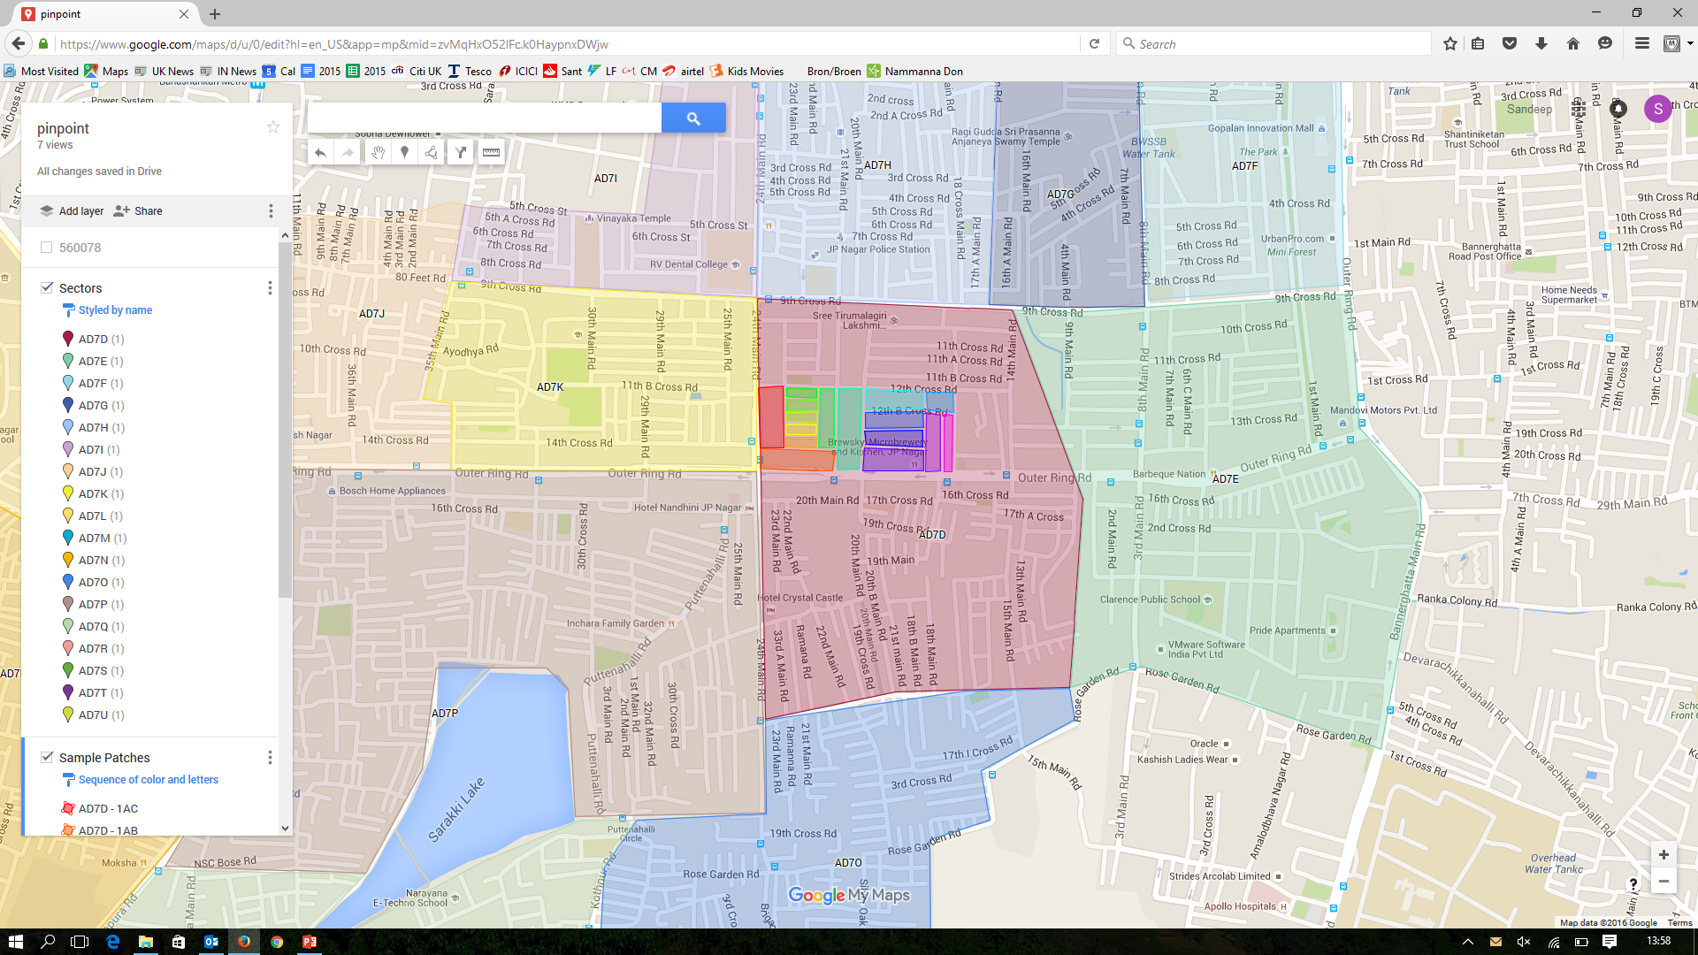
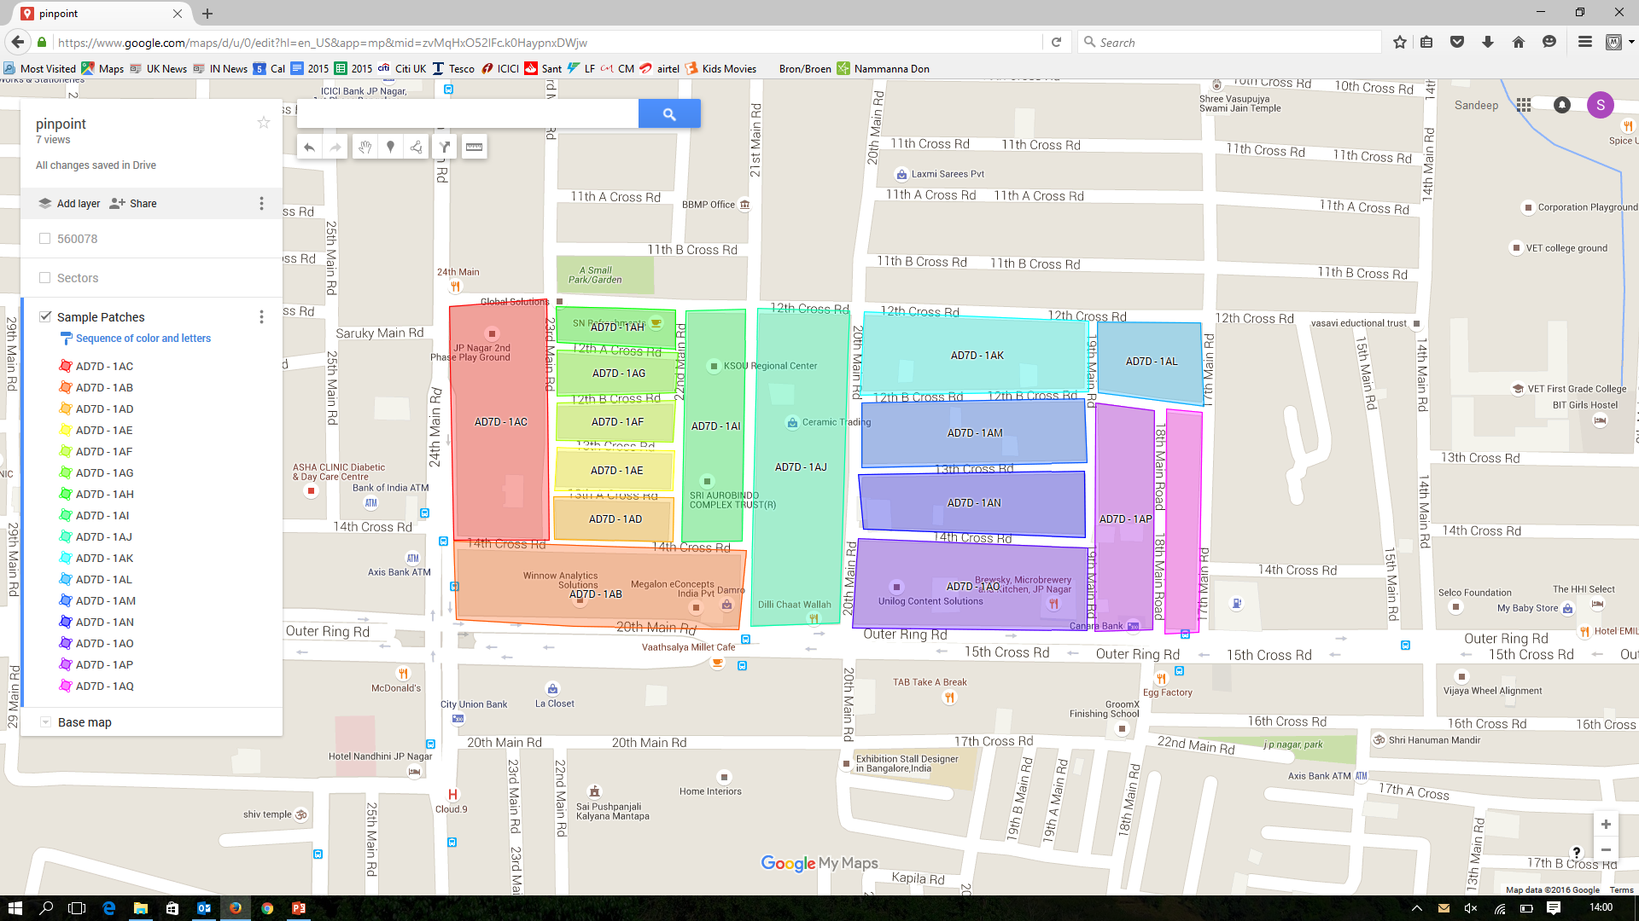

Slide 11
Why India Post?
Alignment with beat codes will simplify the adoption in future for India Post
Aligns with the ongoing NADMS project
Will allow India Post to add value and improve the eCommerce customer journey
Addresses with Pinpoint would be ‘verified’ addresses and hence reduced delivery hassles
Delivery partners could locate the verified address easily on maps using Pinpoint and avoid lengthy conversations about directions
Will allow automated sorting down to beat code level (and even further down if required)

Slide 12
Additional Slides

Slide 13
To do
get india post onboard
Create an address database for JPN – BBMP / voter list / sub registrar / post office + overlay beat code map
Address database should contain address, Pinpoint, Google maps coordinates, ​Pinpoint Plus (this will have two extra chars at the end of Pinpoint to and this will be a unique ID for the property), current Pincode + Beat code for the address
How to get address data from BBMP
Use beat code for India post to adopt
get google maps on board
Address collection / validation on consumer facing eCommerce sites and POS systems as well (e.g. Airtel office, online forms for sites like Amazon and Flipkart) – i.e. wherever an address is captured (either entered by a customer or by an agent on their behalf)
Satnav, Google maps and Courier companies to easily locate the address
Better sorting (courier and India post)
Licence model like QAS
existing addresses for Bangalore - obtain the full list from BBMP / sub-registrar office / panchayat offices? BESCOM is potentially another source with the additional option to use the meter number as well

Slide 14
Something like the O2 Recycle widget for Pinpoint
Experian
Amazon
Post office
DHL and other courier companies
Sumit Tayal
Auto's dad
Obtain address list from BBMP - they can chop off the name and even PID if necessary
Ease of geographic allocation/division of work for govt departments like income tax etc
Better sorting
Amazon
Customer who knows pinpoint journey
Customer who doesn't know his pinpoint - takes him to pinpoint website where he can enter address details to find out pinpoint or find pinpoint using map
Addresses with pinpoint would be verified addresses and hence reduced delivery hassles
Their delivery partners could locate the verified address easily on maps and avoid lengthy conversations about directions (potentially save offline maps and directions to the addresses before they leave the warehouse)
DHL/FedEx
Better sorting
Less delivery hassle
Where address is entered electronically, it can be verified at the point of entry

Slide 15
Current landscape
154797 post offices
145298 are delivery
9499 non delivery
19100 unique pincodes at present out of possible 999999
Assuming 25 beat codes per pincode on average and 20000 pincodes (rounded up from 19100), there are 5,00,000 beat codes at present

Slide 16
Plan
Gradual rollout city by city and state by state
Assumptions
Existing pincode system will need to continue as people who can use digits only will need to be supported
Vehicle registration number across India use roman alphabets
Existing pincode system will need to be supported for backward compatibility
Beat codes for a given pincode are unique even if there are multiple delivery offices for that pincode
154797 post offices of which 145298 are delivery and 9499 are non-delivery. 19100 unique pincodes at present out of 999999 possible. Assuming 25 beat codes per pincode on average and 20000 pincodes (rounded up from 19100), there are 5,00,000 beat codes

Slide 17
Estimated number of postcodes
UK population: 64.5 million
UK postcodes: 1.7 million
Indian population: 1271 million
Using the UK ratio, India would need 33.5 million postcodes

Slide 18
Ref
http://cept.gov.in/lbpsd/placesearch.aspx
http://www.allgov.com/india/departments/ministry-of-communications-and-information-technology/department-of-posts?agencyid=7579
http://www.indiapostnationaladdressdatabase.gov.in/%28S%282wjadoqvkcozxnus2dmhvchy%29%29/Web/NADMSWeb/AddressSearch.aspx
Annual report of India Post
511 post offices in Karnataka with 271 of them being delivery POs

Slide 19
Thoughts for later
pilot with jpnagar say - attach pinpoint sticker at sorting office where the jpnagar post is separated out and give a map of pinpoints to postmen (printed out or smartphone) to help them deliver using pinpoint
new layouts - how to assign postcodes? Whether the india post's way of assigning pincode and beat code can be extended? We will need exact list of property addresses in addition to layout? Will the relevant gram panchayat / subregistrar office help? Who can give us the complete list of new addresses that are being created in such cases?
correction process - so that people can notify us
getting address data from BBMP office
Bescom meter number unique?
Allow businesses to self register - validated by the beat postman? And verify against companies register?
temporary pinpoint of TW18-99ZZ for addresses not on database and they should also request Pinpoint for a new code
http://bcity.in/wards/j-p-nagar
eCommerce sites can blacklist addresses in their system for cash on delivery
How often does beat code change?
http://timesofindia.indiatimes.com/city/chennai/In-tech-age-India-Post-plans-auto-sort-facility/articleshow/31979829.cms
http://systemassistant.blogspot.in/
Mr.Holla mentioned about confusion in cases where an address is in the border area between two pincodes. The post sometimes is sent back by a postman and goes through to the other post office and the postman from there has to deliver it again.

